Slide 1
C# : Crafting Code
Make it readable

Slide 2
Overview
Standards and best practices
What is language oriented programming?
Fluent Interfaces
Declarative Programming
Domain specific languages

Slide 3
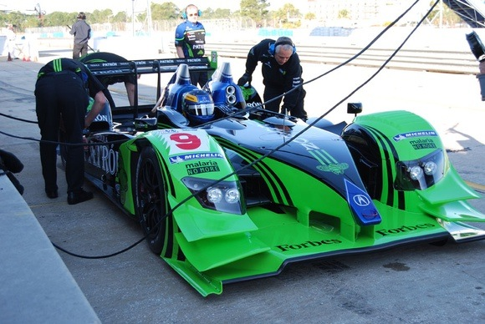
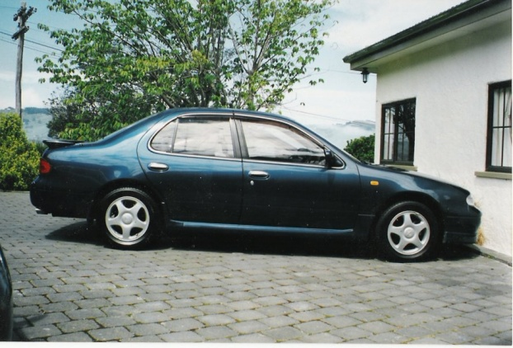
Language Oriented Programming
Domain
Specific
Language
General
Purpose
Language

Slide 4
Language Oriented
Examples
SQL, regular expressions, CSS selectors
Benefits
Specialized language can increase productivity
Narrows gap between you and customer
Easy to separate concerns
Drawbacks
Can be expensive to create (and possibly learn)
Difficult to implement in C#

Slide 5
Language Oriented C#
Extension methods
For better APIs
Expression trees
For static reflection
Funcs and Actions
For functional, declarative programming

Slide 6
Example Scenario
Scheduling tasks for periodic execution
public class ScheduledTask {
public ScheduledTask(ITask task,
TimeSpan interval,
TimeSpan expiration) {
Task = task;
Interval = interval;
Expiration = expiration;
}
public ITask Task { get; protected set; }
public TimeSpan Interval { get; protected set; }
public TimeSpan Expiration { get; protected set; }
...
}
?
var task = new ScheduledTask(
new AccountSynchronizationTask(),
new TimeSpan(0, 0, 2, 0),
new TimeSpan(2, 0, 0, 0));

Slide 7
Goals
Readability
Easier to maintain
Essence over ceremony
Remove language clutter
var task = new ScheduledTask(
new AccountSynchronizationTask(),
new TimeSpan(0, 0, 2, 0),
new TimeSpan(2, 0, 0, 0));

Slide 8
Named parameters
Only a small step forward
Particularly useful when combined with optional parameters
Gives reader a clue when using constants
var task = new ScheduledTask(
Tasks.AccountSynchronization,
runEvery: new TimeSpan(0, 0, 2, 0),
expiresIn: new TimeSpan(2, 0, 0, 0));

Slide 9
Extension Methods
Extend types!
Even sealed types, generic types, and interfaces
public static class StringExtensions
{
public static int ToInt32(this string value)
{
return Int32.Parse(value);
}
}
int value = "32".ToInt32();

Slide 10
Fluent APIs
A readable API
Often uses method chaining
var then = 2.Minutes().Ago();
public static TimeSpan Minutes(this int value)
{
return new TimeSpan(0, 0, value, 0, 0);
}
public static DateTime Ago(this TimeSpan value)
{
return SystemTime.Now() - value;
}

Slide 11
Putting It Together
public static class Tasks
{
public static ScheduledTask Schedule(ITask task,
TimeSpan runEvery,
TimeSpan expireIn)
{
return new ScheduledTask(task, every, expiresIn);
}
public static ITask AccountSynchronization
{
get { return new AccountSynchronizationTask(); }
}
}
var task = new ScheduledTask(
new AccountSynchronizationTask(),
new TimeSpan(0, 0, 2, 0),
new TimeSpan(2, 0, 0, 0));
var task = Tasks.Schedule(Tasks.AccountSynchronization,
runEvery: 2.Minutes(),
expireIn: 5.Days());

Slide 12
Validation Example
Dealing with requirements in the form of complex flowcharts
Model them with procedural if/else code
Or …
var chart = new MovieFlowchart();
chart.WithShape("CheckTitle")
.RequiresField(m => m.Title)
.WithArrowPointingTo("CheckLength")
.AndTheRule(m => !String.IsNullOrEmpty(m.Title))
.WithShape("CheckLength")
.RequiresField(m => m.Length)
.WithArrowPointingTo("BadMovie")
.AndTheRule(m => m.Length > 120)
.WithArrowPointingTo("GoodMovie")
.AndTheRule(m => m.Length == 75)
.WithArrowPointingTo("CheckReleaseDate")
.AndTheRule(m => m.Length.HasValue)
. . .
.WithShape("BadMovie").YieldingResult(MovieResult.BadMovie)
.WithShape("GoodMovie").YieldingResult(MovieResult.GoodMovie);

Slide 13
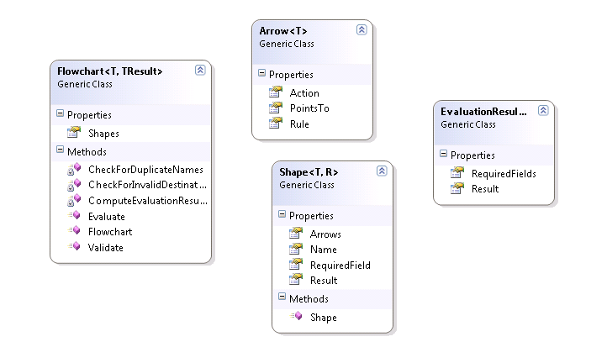
Semantic Model
In-memory representation of what a DSL describes
A domain model built by the DSL

Slide 14
Building the Fluent API / DSL
Heavy use of extension methods
public static Flowchart<T, R> WithShape<T, R>(
this Flowchart<T, R> chart, string shapeName)
{
var shape = new Shape<T, R> { Name = shapeName };
chart.Shapes.Add(shape);
return chart;
}
public static Flowchart<T, R> YieldingResult<T, R>(
this Flowchart<T, R> chart, R result)
{
chart.LastShape().Result = result;
return chart;
}

Slide 15
Taking Advantage of Expression<T>
Expression<T> can yield rich meta-data about a piece of code
“Static” reflection
public PropertySpecifier(Expression<Func<T, object>> expression)
{
if(expression.Body is MemberExpression)
{
var me = expression.Body as MemberExpression;
_propertyName = me.Member.Name;
}
else if(expression.Body is UnaryExpression)
{
var ue = expression.Body as UnaryExpression;
var me = ue.Operand as MemberExpression;
_propertyName = me.Member.Name;
}
}

Slide 16
My Top 10 Rules

Slide 17
Rule #10: Avoid Regions
public class AccountManager
{
#region UserManagement
...
#endregion
#region RoleManagement
...
#endregion
#region DataAccess
...
#endregion
}

Slide 18
Rule #9: Use Exceptions For Errors
… instead of status code or booleans
… but not for control flow
public bool Login(string userName, string password)
{
if (String.IsNullOrEmpty(userName))
{
return false;
}
// ....
return true;
}

Slide 19
Rule #8: Avoid Boolean Parameters
public void WriteFile(byte[] contents, bool flush)
{
// ....
}
storage.WriteFile(data, false);
public void WriteFile(byte[] contents)
{
WriteFile(contents, false);
}
public void WriteFileAndFlush(byte[] contents)
{
WriteFile(contents, true);
}
private void WriteFile(byte[] contents, bool flush)
{
// ...
}

Slide 20
Rule #7: Avoid Too Many Parameters
public void LoginUser(string username, string password,
IPAddress ipAddress, bool persist)
{
// ...
}
public void LoginUser(UserLoginRequest request)
{
// ...
}

Slide 21
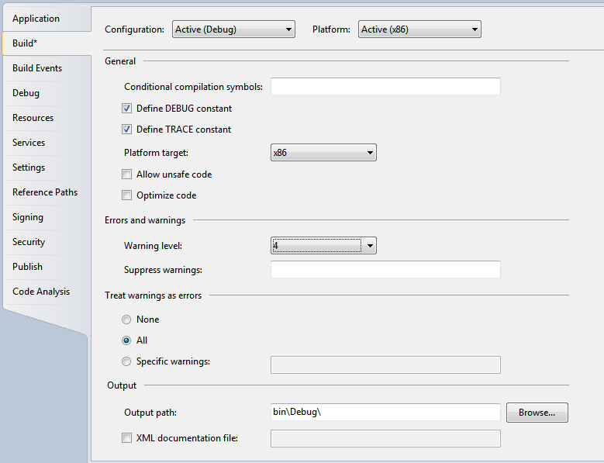
Rule #6: Warnings Are Errors

Slide 22
Rule #5: Encapsulate Complex Expressions
if (account.Balance > 0 && !account.IsVip && account.DueDate > CurrentDate)
{
// send off a warning
}
if (account.IsPastDue)
{
// ...
}

Slide 23
Rule #4: Try To Avoid Multiple Exits
if (account.Balance < 10000)
{
return false;
}
else if (account.IsPastDue)
{
return false;
}
else if (account.IsVip)
{
return false;
}
return true;
var isValid = true;
if (account.Balance < 10000)
{
isValid = false;
}
else if (account.IsPastDue)
{
isValid = false;
}
else if (account.IsVip)
{
isValid = false;
}
return isValid;

Slide 24
Rule #3: Try To Avoid Comments
// ensure we don't send a notification to
// important people
if (account.IsVip && account.IsPastDue)
{
SendNotification = false;
}
CancelNotificationForVipAccounts();

Slide 25
Rule #2: Keep Methods Short
private string BuildLogParameters(HttpContext context, string SubModuleKey, string ownerType, string PageType, string Url)
{
StringBuilder _parameters = new StringBuilder("");
if (PageType == "Rapid") //should no longer have any overlap between indigo and rapid;
{
_parameters.Append("R,");
}
else if (PageType == "Indicator")
{
_parameters.Append("I,");
}
else
{
_parameters.Append("U,");//Unknown
}
_parameters.Append(SessionObject.UserId + ",");
_parameters.Append(SessionObject.PatientDataAccess + ",");
_parameters.Append(System.DateTime.Now);
_parameters.Append(",");
_parameters.Append(SubModuleKey + ",");
_parameters.Append(ownerType + ",");
if (context.Request.QueryString == null)
{
_parameters.Append("null");
}
else
{
_parameters.Append(context.Request.QueryString.ToString());
}
_parameters.Append(",");
if (context.Request.QueryString["VisitIdentity"] != null)
{
_parameters.Append(context.Request.QueryString["VisitIdentity"].ToString());
}
else
{
_parameters.Append("null");
}
_parameters.Append(",");
_parameters.Append(context.Request.RawUrl);
_parameters.Append(",");
_parameters.Append(PageType[0]);
_parameters.Append(",");
if (SubModuleKey == "0" || ownerType == "0")
_parameters.Append(((Page)context.CurrentHandler).Title);
else
_parameters.Append("");
_parameters.Append(",");
_parameters.Append(Url);
return (_parameters.ToString());
}

Slide 26
Rule #1: Keep Classes Small
private string BuildLogParameters(HttpContext context, string SubModuleKey, string ownerType, string PageType, string Url)
{
StringBuilder _parameters = new StringBuilder("");
if (PageType == "Rapid") //should no longer have any overlap between indigo and rapid;
{
_parameters.Append("R,");
}
else if (PageType == "Indicator")
{
_parameters.Append("I,");
}
else
{
_parameters.Append("U,");//Unknown
}
_parameters.Append(SessionObject.UserId + ",");
_parameters.Append(SessionObject.PatientDataAccess + ",");
_parameters.Append(System.DateTime.Now);
_parameters.Append(",");
_parameters.Append(SubModuleKey + ",");
_parameters.Append(ownerType + ",");
if (context.Request.QueryString == null)
{
_parameters.Append("null");
}
else
{
_parameters.Append(context.Request.QueryString.ToString());
}
_parameters.Append(",");
if (context.Request.QueryString["VisitIdentity"] != null)
{
_parameters.Append(context.Request.QueryString["VisitIdentity"].ToString());
}
else
{
_parameters.Append("null");
}
_parameters.Append(",");
_parameters.Append(context.Request.RawUrl);
_parameters.Append(",");
_parameters.Append(PageType[0]);
_parameters.Append(",");
if (SubModuleKey == "0" || ownerType == "0")
_parameters.Append(((Page)context.CurrentHandler).Title);
else
_parameters.Append("");
_parameters.Append(",");
_parameters.Append(Url);
return (_parameters.ToString());
}

Slide 27
Summary
Language Oriented Programming
Useful in complex domains
Increases productivity, maintainability, separation of concerns
Trade Offs
Effort required to create DSL / Fluent API in C#

